Slide 1

Lightweight Deep Learning for Real-time Polyp Identification and Segmentation in Colonoscopy: The Nano-Net Approach
By: KOORAPETSE LESOTLHO (3121999299) Supervisor: SN ENGR. Qi Yang Master of Computer Science and Technology

Slide 2
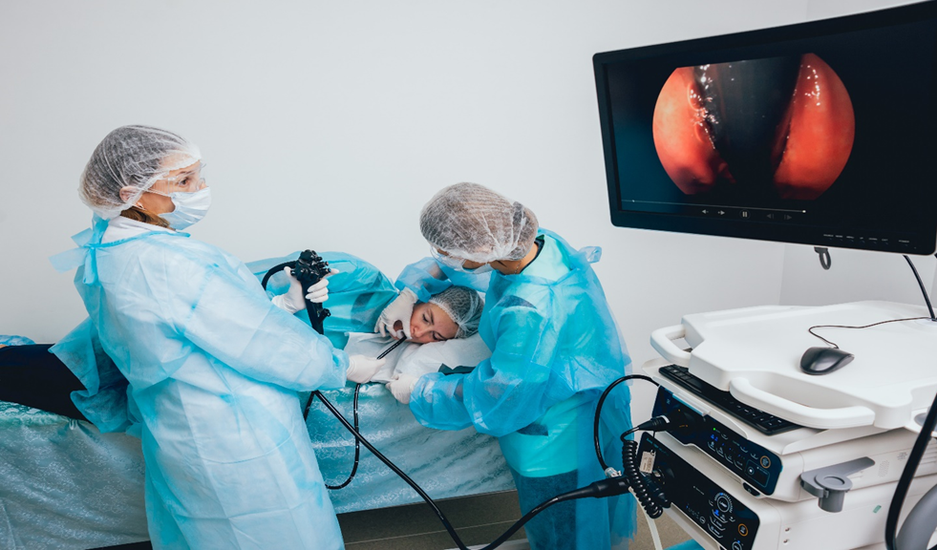
Introduction and Background of The Research Topic
Computer vision breakthroughs, particularly in the field of medical image processing, offer significant potential for changing healthcare technology. Deep Learning (DL) has demonstrated tremendous promise in this field, and the FDA has already authorized numerous AI-based medical devices and algorithms.
In medicine, machine learning (ML) has a wide range of applications, including diagnosis, prognosis, treatment, drug discovery, and epidemiological research. ML algorithms like the Lymph Node Assistant (LYNA) and Deep Learning-based Automatic Detection (DLAD) have shown to be useful complementary tools for physicians, and imaging-based DL algorithms have the potential to increase physician diagnostic accuracy.
In medical image interpretation, ML models paired with Computer-aided Detection (CADe) or Computer-aided Diagnosis (CADx) systems can greatly improve clinician decision-making. These models serve as secondary observers, enhancing the accuracy of early diagnosis and perhaps decreasing death rates. They also help to improve physician performance and protect patients.
The application of machine learning in medicine has various advantages, including enhanced accessibility, particularly in low- and middle-income nations. Machine learning and deep learning systems are more efficient, cost-effective, ethical, and generate reproducible outcomes. These developments have the potential to transform healthcare by enhancing medical picture interpretation, assisting clinician decision-making, and benefiting both patients and medical personnel.
Notes:
Challenges in GI Cancer Detection and Diagnosis: Gastrointestinal cancers, particularly colorectal and stomach cancers, pose significant challenges in detection and diagnosis. Current methods like gastroscopy and colonoscopy often miss early precursors of these cancers, leading to higher mortality rates in later stages. Limited resources, physical demands on healthcare professionals, and patient discomfort contribute to these challenges, highlighting the need for automated CADx-based support systems.
Role of Computer-Aided Systems: Computer-aided detection and diagnosis (CADx and CADe) systems offer potential solutions for improving GI cancer detection and diagnosis. By leveraging advanced technologies, these systems can enhance adenoma detection rates and improve patient outcomes. Automated procedures for the upper and lower GI tract can increase accessibility, cost-effectiveness, and efficiency of examinations, leading to better overall healthcare provision and addressing the global burden of GI cancers.

Slide 3

Research aims and objectives
Primary goal: The primary objective of this research is to develop lightweight weight automated algorithms for the classification, detection, and segmentation of images and videos from the Gastrointestinal tract in order to improve the precision and speed of CADe and CADx systems. This will allow for the automatic identification, detection, and segmentation of potential gastrointestinal lesions that are captured by conventional endoscopy, colonoscopy, or wireless capsule endoscopy (WCE). In addition, one of our goals is to design models that are easy to implement, have consistent and reliable performance over a wide range of datasets, are quickly customizable, and don't interfere with the functioning of endoscopic tools.
Objective I: To propose a novel architecture, Nano-Net, that is lightweight, efficient, and capable of real-time performance for colonoscopy image segmentation.
Objective II: Explore, investigate, and design ML and DL classification and polyp detection methods for the GI tract.
Objective III: To develop efficient medical image segmentation algorithms for colorectal adenoma segmentation and medical image segmentation in general. The objective of this research is to enhance the precision and robustness of deep learning models on public colonoscopy datasets. The purpose of this study is to evaluate the performance of Nano-Net using metrics such as precision, mean IoU, dice coefficient, and frames per second, and to demonstrate its potential for enhancing early detection and decreasing the rate of missed polyp detection.
Notes:
Overview of the research methodology, including data collection, preprocessing, network architecture design, and evaluation metrics.
Overview of research methodology
Data collection: collection of endoscopic images from various sources
Data preprocessing: data augmentation, resizing, and normalization
Network architecture design: design of Nano-Net with stronger characterization capabilities
Evaluation metrics: precision, recall, F1 score, and accuracy
…………………………………………………………………………………………….

Slide 4

Research methodology
Theory: Theoretical framework in research is based on mathematical principles and includes the development of sound theories. It involves classifying theories into four categories and applying them to various techniques in medical image processing and Convolutional Neural Network (CNN) architectures.
Abstraction: Modeling relies on the process of abstraction, which involves hypothesis development, model creation, experiment planning and data collection, and analysis of findings. Experiments in this thesis involve dataset collection and annotation, preprocessing, feature extraction, multi-class classification, and semantic image segmentation.
Design: Design is a crucial part of the modeling process and is divided into hypothesis creation, model development, experiment planning and data collection, and evaluation of outcomes. The thesis includes tests, studies, and contests involving dataset collection, image segmentation, detection, and localization in gastrointestinal endoscopy, as well as machine learning techniques, preprocessing, feature extraction, multi-class classification, and semantic image segmentation. The effectiveness of approaches is evaluated using computer vision measures.

Slide 5
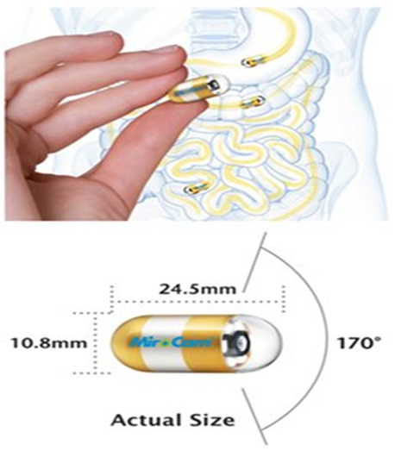
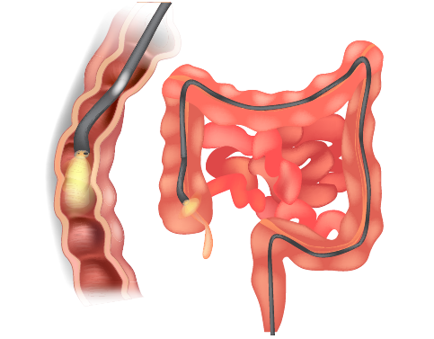
Colonoscopy
Figure c: Example of a colonoscope
a: Wireless Capsule Endoscopy
c: A colonoscope being inserted into the colon

Slide 6

Discussion of the challenges faced by automatic polyp image segmentation
Data Imbalance and Normal Map:
Uneven distribution of data categories and the normal map pose significant challenges for employing deep learning to recognize polyps.
Existing deep learning approaches struggle with unbalanced medical datasets and data imbalance issues.
The assumption of balanced datasets limits the effectiveness of current techniques in clinical applications.
Lack of Annotated Datasets:
The scarcity of annotated datasets hinders the training and evaluation of polyp image recognition algorithms.
Complexities in polyp pictures, including variations in quality, lighting, and orientation, further complicate the training and assessment process.
Overcoming the lack of annotated datasets is crucial for achieving accurate performance and identifying polyps.
Complexity of Polyp Pictures:
The intricate shapes and structures of polyps make it challenging for automatic recognition systems to differentiate and recognize them accurately.
Advanced deep learning architectures, such as encoder-decoder networks and U-Nets, are necessary to address the complexity of polyp pictures.
Lightweight and Low-Latency Algorithms:
The need for lightweight and low-latency algorithms arises due to limited processing power and storage capacity of endoscopic devices.
Researchers have developed lightweight models and utilized techniques like model compression and hardware acceleration to ensure real-time performance on low-end hardware.
Notes:
Challenges faced by automatic polyp image segmentation
Low contrast: difficulty in distinguishing polyps from surrounding tissue
Variable size and shape: difficulty in accurately segmenting polyps of different sizes and shapes
Presence of noise: interference from artifacts and speckle noise in endoscopic images
Solutions proposed in literature
……………………………………………………………………………………………………………
Overall, continuous development and improvement of deep learning architectures and methods are required to address the challenges associated with polyp image recognition. This includes addressing data distribution and imbalance, obtaining annotated datasets, tackling the complexity of polyp images, and developing lightweight algorithms that support real-time performance on low-end hardware. Standardized benchmarking methods are also necessary for unbiased comparisons and evaluation of different techniques.

Slide 7
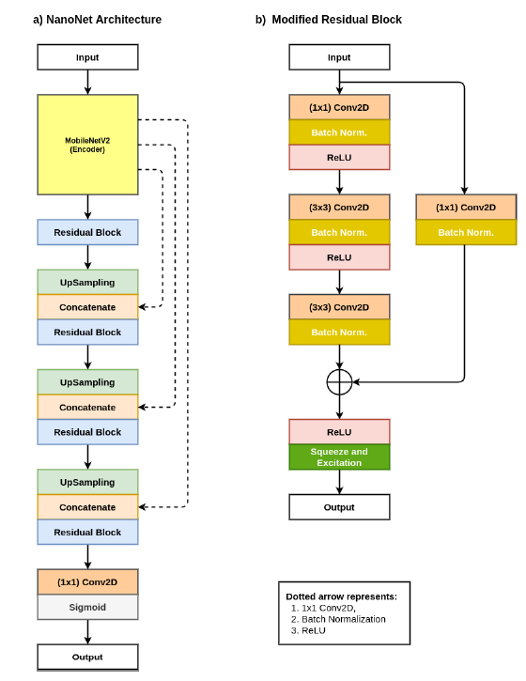
Introduction to the Nano-Net approach, including the network architecture and the data set used for polyps' recognition.
NanoNet Architecture:
NanoNet is a neural network architecture consisting of an encoder followed by a decoder.
The encoder is pre-trained using MobileNetV2, and it gradually increases the number of feature channels while down sampling the feature maps.
The decoder utilizes a modified residual block and incorporates skip connections to improve the quality of feature maps.
Encoder and Decoder:
The pre-trained encoder receives processed image data and applies a normal convolution followed by a bottleneck layer.
Convolutional procedures use a default kernel size of 3x3.
The decoder increases the spatial dimensions of feature maps through bilinear up sampling.
Skip connections are used to concatenate matching feature maps from the encoder to preserve information across layers.
The revised residual block analyzes the concatenated feature maps, enhancing the generalization power of the decoder.
Output and Activation Functions:
After processing by all three decoder blocks, the output is passed to a 1x1 convolution layer with several classes as feature channels.
For binary segmentation, the sigmoid activation function is used; otherwise, the SoftMax activation function is used.
Notes:
NanoNet Designs A, B, and C:
NanoNet offers three different designs: A, B, and C.
NanoNet-A utilizes 32, 64, or 128 feature channels in the decoder block.
NanoNet-B can use 32, 64, or 96 feature channels.
NanoNet-C reduces the feature channels to 16, 24, and 32.
Reducing the number of feature channels in NanoNet-C results in a lightweight network with fewer trainable parameters and reduced model complexity.
First Model developed…

Slide 8
Discussion of the experimental setup, including the datasets used, evaluation metrics, implementation details, and data augmentation techniques.
The dataset is the collection of data that was utilized in this research; it serves as the foundation for the whole inquiry. As a consequence of this, it is absolutely necessary to offer a detailed description of the dataset that was utilized, including information on its size, its origin, and any preparation steps that were carried out. In addition, it is necessary to provide a justification for the use of this specific dataset as opposed to other possibilities and to emphasize both its strengths and drawbacks.
Dataset | Imaging Type | Availability
KvasirCapsule-SEG |  | https://www.dropbox.com/sh/hr46vieykbmvmkk/ AAAs V8ECG0wq51Fpw3rYU 5a?dl=0
Kvasir-SEG | Colonoscopy | https://datasets.simula.no/kvasir-seg/
2020 Medico automatic polyp segmentation challenge | Colonoscopy | https://multimediaeval.github.io/editions/2020/tasks/ medico/
Endotect Challenge Dataset | Colonoscopy | https://endotect.com/
Kvasir-Instrument | Colonoscopy | https://datasets.simula.no/kvasir-instrument/
Table 1; Publicly available endoscopic datasets used in our experiments
Notes:
The study involved collecting the polyp class from the tagged pictures folder of the Kvasir-Capsule dataset. With the help of a gastroenterologist, the polyp class was annotated to address the challenge of segmenting polyps from video capsule endoscopy images. The Kvasir-Capsule dataset is freely accessible and contains labeled anomalies and discoveries grouped into thirteen categories. However, only 55 polyp frames out of a total of 44,228 medically proven video capsule frames are included in the dataset. The polyp class in the Kvasir-Capsule dataset has been annotated, and ground truth masks have been created based on these annotations. Figure 2 shows examples of KvasirCapsule-SEG colonies and their corresponding covers. Additionally, information on bounding boxes for detection and localization tasks related to endoscopic video capsules is provided.
The Kvasir-Capsule can be downloaded from a specific URL on your computer, and both version 1.1 and KvasirCapsule-SEG are available for download. Table I contains information about the publicly available imaging dataset used in the conducted studies, including a column for ground truth corresponding to each dataset. The table provides the web address (URL) for each dataset. The "Medico automated polyp segmentation challenge" and the "Endotect challenge" utilize Kvasir-SEG as the standard training setting. The challenge organizers have provided participants with 160 previously unseen photographs for the "Medico automated polyp segmentation challenge" and 200 previously unseen images for the "Endotect challenge" to evaluate participants' methods. The experiments were conducted using the official division of the Kvasir-instrument dataset, which was made available by the organizers

Slide 9
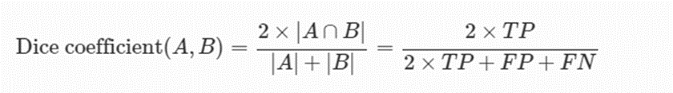
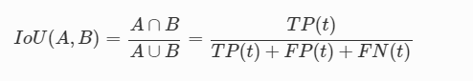
Experimental Setup
In this research, our suggested model's performance was evaluated using standard metrics from computer vision. The metrics used were the Dice Coefficient (DSC), mean Intersection over Union (mIoU), Precision, Recall, Specificity, Accuracy, and Frames-per-second (FPS).
The Dice Coefficient is a metric commonly used to assess segmentation methods. It measures the overlap between two binary masks, ranging from 0 to 1. A value of 1 indicates a perfect match between the predicted and ground truth masks. mIoU evaluates the average intersection over union of predicted and ground truth masks across all classes, which is particularly useful for imbalanced datasets with underrepresented classes.
Intersection over Union (IoU) is another metric used to evaluate segmentation strategies. It calculates the similarity between a predicted value (A) and the corresponding ground truth value (B) using a specific equation.
Equation 2 introduces the variable "t" representing the threshold. It computes the precision value for each threshold value by comparing predicted items with the ground truth items using the previously discussed equation and parameters. When performing frame-wise image classification tasks, other criteria such as recall, specificity, precision, and accuracy are considered.
Notes:
To assess a model's capacity to reliably categorize positive and negative events, binary classification tests use accuracy, recall, and specificity. Precision is the percentage of true positives among anticipated positives, whereas recall is the percentage of true positives among actual positives. Precision and memory are both critical for diagnostic accuracy. Specificity, on the other hand, assesses the percentage of real negative occurrences that are accurately detected. Accuracy is a valuable statistic used in classification jobs that determines the percentage of properly identified cases overall. However, it may not be appropriate for datasets with unequal class distributions.
We devised the Frames Per Second (FPS) metric to evaluate the computing performance of our suggested approach. The number of frames processed per second (FPS) is important for real-time applications that demand quick processing speeds. Using these standard measurements, we want to give a complete evaluation of our model's performance across multiple computer vision tasks, such as segmentation and classification.

Slide 10
Implementation details & Data Augmentation
Keras and TensorFlow were used as backends for developing the NanoNet model. The model was tested on a Lenovo ThinkPad T470s with an Intel Core i5-7300U CPU clocked at 2.60 GHz and an Intel SoC architecture. The source code for the NanoNet model can be found at https://github.com/lesotlhok/TheaNanoNet. The model used a batch size of 16 and input images of size 256x256 pixels to optimize computational resources and training time.
The model was trained using the nadam optimizer with a learning rate of 1e-4 and the dice coefficient as the loss function. The dice coefficient is effective for segmentation tasks, measuring the similarity between predicted and ground truth masks. A more moderate learning rate was chosen to ensure gradual adjustment of model parameters, leading to improved convergence.
To enhance training, the learning rate was reduced by 0.1 percentage points if the validation loss remained unchanged for ten consecutive epochs. This approach prevents overtraining and stabilizes the training process. Additionally, early stopping was implemented based on the validation loss. Training was stopped after a certain number of iterations if the loss did not decrease, aiming to prevent overfitting. By carefully selecting hyperparameters and training techniques, it is expected to improve both training efficiency and the functionality of the NanoNet model.
TABLE2: Evaluation of the proposed network performance and contemporary SOTA approaches on the KvasirCapsule-SEG
Methods | Parameter | DSC | mIoU | Recall | Precision | F2 | Accuracy | FPS
ResUNet (GRSL’18) [38] | 8,227,393 | 0.9532 | 0.9137 | 0.9785 | 0.9325 | 0.9677 | 0.9386 | 17.96
ResUNet++ (ISM’19) [24] | 4,070,385 | 0.9499 | 0.9087 | 0.9762 | 0.9296 | 0.9648 | 0.9334 | 15.39
NanoNet-A | 235,425 | 0.9493 | 0.9059 | 0.9693 | 0.9325 | 0.9609 | 0.9351 | 28.35
NanoNet-B | 132,049 | 0.9474 | 0.9028 | 0.9682 | 0.9308 | 0.9593 | 0.9324 | 27.39
NanoNet-C | 36,561 | 0.9465 | 0.9021 | 0.9754 | 0.9238 | 0.9629 | 0.9297 | 29.48

Slide 11
Implementation details & Data Augmentation
TABLE 3 Evaluation of the proposed network performance and contemporary SOTA approaches on the Kvasir-SEG [15]
Methods | Parameter | DSC | mIoU | Recall | Precision | F2 | Accuracy | FPS
ResUNet (GRSL’18) [38] | 8,227,393 | 0.720 | 0.610 | 0.7602 | 0.7624 | 0.7327 | 0.9251 | 17.72
ResUNet++ (ISM’19) [24] | 4,070,385 | 0.731 | 0.636 | 0.7925 | 0.7932 | 0.7478 | 0.9223 | 19.79
NanoNet-A | 235,425 | 0.8227 | 0.7282 | 0.8588 | 0.8367 | 0.8354 | 0.9456 | 26.13
NanoNet-B | 132,049 | 0.7860 | 0.6799 | 0.8392 | 0.8004 | 0.8067 | 0.9365 | 29.73
NanoNet-C | 36,561 | 0.7494 | 0.6360 | 0.8081 | 0.7738 | 0.7719 | 0.9290 | 32.17
TABLE 4: Evaluation of the proposed network performance and contemporary SOTA approaches on the Medico 2020 dataset [17]
Methods | Parameter | DSC | mIoU | Recall | Precision | F2 | Accuracy | FPS
ResUNet (GRSL’18) [38] | 8,227,393 | 0.6846 | 0.5599 | 0.7235 | 0.7236 | 0.6961 | 0.9231 | 18.54
ResUNet++ (ISM’19) [24] | 4,070,385 | 0.6925 | 0.5849 | 0.8249 | 0.6840 | 0.7434 | 0.8995 | 19.47
NanoNet-A | 235,425 | 0.7364 | 0.6319 | 0.8566 | 0.7310 | 0.7804 | 0.9166 | 28.07
NanoNet-B | 132,049 | 0.7378 | 0.6247 | 0.8283 | 0.7373 | 0.7685 | 0.9223 | 29.04
NanoNet-C | 36,651 | 0.7070 | 0.5866 | 0.8095 | 0.7089 | 0.7432 | 0.9148 | 32.66
TABLE 5: Evaluation of the proposed network performance and contemporary SOTA approaches on the Endotect 2020 dataset [18]
Methods | Parameter | DSC | mIoU | Recall | Precision | F2 | Accuracy | FPS
ResUNet (GRSL’18) [38] | 8,227,393 | 0.6640 | 0.5408 | 0.7510 | 0.6841 | 0.6943 | 0.9075 | 26.55
ResUNet++ (ISM’19) [24] | 4,070,385 | 0.6940 | 0.5838 | 0.8797 | 0.6591 | 0.7597 | 0.8841 | 18.58
NanoNet-A | 235,425 | 0.7508 | 0.6466 | 0.8238 | 0.7744 | 0.7773 | 0.9255 | 27.19
NanoNet-B | 132,049 | 0.7362 | 0.6238 | 0.8109 | 0.7532 | 0.7646 | 0.9252 | 29.91
NanoNet-C | 36,651 | 0.7001 | 0.5792 | 0.8000 | 0.7159 | 0.7380 | 0.9091 | 32.98
Notes:
To enhance our deep learning model's effectiveness and applicability, we used various techniques to supplement the training data.
These methods aimed to increase dataset diversity by generating new versions of existing images. This approach helped the model
learn more robust and distinctive features, enabling it to handle previously unknown data.
Multiple data augmentation strategies were employed, including grid distortion, random cropping and rotation, and horizontal and
vertical flipping. Offline processing was utilized, creating augmented images stored on disk before the training phase. This approach
reduced computational waste during training, speeding up iteration and testing with different augmentation levels.
While data augmentation can improve deep learning model performance, it must be used cautiously. Excessive or exaggerated changes
to the data may lead to overfitting or the acquisition of irrelevant or misleading features, resulting in performance deterioration.
Only the training set was expanded, and the model's effectiveness was evaluated based on its performance on the original validation
and testing datasets. These sets were not augmented but scaled to a 256×256 resolution, ensuring consistent results across all sets.
By assessing the model's performance on unseen data, we could make informed judgments about the success of our augmentation strategy.

Slide 12
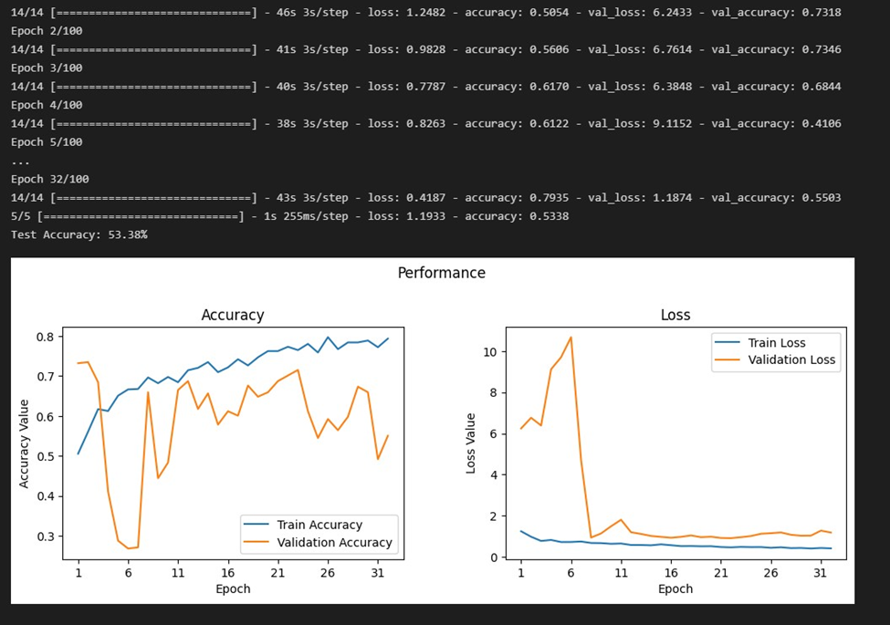
Pre-trial Model developed
The study focuses on developing a convolutional neural network (CNN) model for label-based picture classification, with the aim of accurately identifying photos based on annotations. This classification is vital for medical imaging, object identification, and autonomous vehicle navigation systems.
The training process is accelerated using the TensorFlow library and GPU, reducing model construction time and allowing researchers to experiment with various models and hyperparameters efficiently.
The model development involves creating separate training and test sets from the dataset, constructing the CNN model with its optimizer, loss, and metrics. Overfitting is addressed through early stopping and evaluation of both training accuracy and validation loss.
While the final model achieves a test accuracy of 53%, further progress is needed, as a minimum accuracy of 80% is required for most applications. Potential solutions include acquiring additional data, exploring different architectures and hyperparameters, utilizing data augmentation techniques, employing regularization strategies, and experimenting with various optimizers and starting strategies. Ongoing study and experimentation are crucial to enhancing the model's performance and applicability.

Slide 13
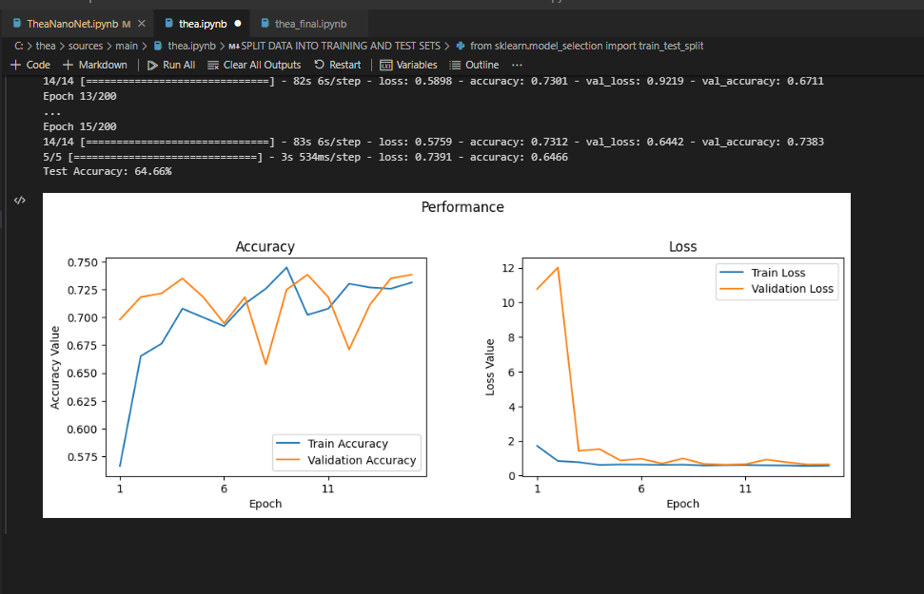
Finetuning and Performance Improvement
Acquiring more data significantly improves the performance of machine learning models, as evidenced by a noticeable 14% boost in accuracy when more data was included in the current case study.
The inclusion of a larger and more diverse dataset allowed the model to identify and generalize more detailed and subtle patterns, leading to the observed improvement in performance.
The development of a fine-tuning technique, inspired by Lightweight Deep Learning for Real-time Polyp Detection and Segmentation in Colonoscopy, facilitated the optimization of the model's architecture and parameters without compromising accuracy. This technique involved methods such as knowledge distillation, pruning, and quantization.
The results highlight the importance of utilizing a large dataset with diverse data and employing advanced approaches to enhance the development and refinement of machine learning models. The source code used for implementing the preliminary model can be found at https://github.com/lesotlhok/Thea.
Notes:
The experimental findings of applying the NanoNet model to an endoscopic image dataset demonstrate significant improvement.
Despite having fewer parameters, the model offers a straightforward and small architecture, providing a reliable solution for real-time applications.
NanoNet outperforms or closely matches the performance of state-of-the-art computer vision methods, achieving real-time
segmentation and surpassing them in various performance measures.
Qualitative analysis shows that NanoNet is capable of accurately segmenting a wide range of polyps and therapy tools, including big, medium, and tiny polyps.
The results suggest that endoscopic image analysis and diagnosis can benefit from segmentation methods based on deep learning,
highlighting the potential of NanoNet in improving image analysis and diagnosis using endoscopic equipment.

Slide 14
Conclusion and Future works
The NanoNet architecture proposed in this article offers a lightweight and innovative approach for real-time image segmentation of endoscopic and colonoscopic images. It incorporates a modified residual block and a pre-trained MobileNetV2 model, utilizing depthwise separable convolution to achieve accurate segmentation while reducing model size and computational complexity.
Experimental results demonstrate that the NanoNet architecture outperforms existing state-of-the-art models in terms of both accuracy and processing speed. Its small number of parameters, competitive accuracy, and low latency make it suitable for implementation in clinical systems, potentially improving patient outcomes and reducing clinician workload.
The NanoNet architecture does not require initialization, post-processing, or temporal regularization, simplifying model complexity and implementation. Its lightweight design makes it well-suited for deployment on embedded systems or mobile devices, expanding its potential applications.
Future work should focus on developing an even lighter-weight encoder than the MobileNetV2 model, further reducing computational costs and enhancing overall efficiency. Additionally, evaluating the performance of the planned model in a clinical setting and expanding its application to other gastrointestinal disorders would contribute to the advancement of automated image segmentation and clinical decision-making in the field. High-quality, diverse datasets and rigorous statistical analysis are necessary to fully assess the strengths, limitations, and clinical relevance of the proposed approaches.
Notes:
Summary of the main contributions and findings of the research

Slide 15
References
Jha, D., Ali, S., Tomar, N. K., Johansen, H. D., Johansen, D., Rittscher, J., Riegler, M. A., & Halvorsen, P. (2021). Real-Time Polyp Detection, Localization and Segmentation in Colonoscopy Using Deep Learning. IEEE access: practical innovations, open solutions, 9, 40496–40510. https://doi.org/10.1109/ACCESS.2021.3063716
Asplund, J., Kauppila, J.H., Mattsson, F., & Lagergren, J. (2018). Survival Trends in Gastric Adenocarcinoma: A Population-Based Study in Sweden. Annals of Surgical Oncology, 25, 2693 - 2702.
Holme, Ø., Bretthauer, M., Fretheim, A., Odgaard-Jensen, J., & Hoff, G. (2013). Flexible sigmoidoscopy versus faecal occult blood testing for colorectal cancer screening in asymptomatic individuals. The Cochrane database of systematic reviews, 2013(9), CD009259. https://doi.org/10.1002/14651858.CD009259.pub2
Jha, D., Smedsrud, P.H., Riegler, M., Johansen, D., Lange, T.D., Halvorsen, P., & Johansen, H.D. (2019). ResUNet++: An Advanced Architecture for Medical Image Segmentation. 2019 IEEE International Symposium on Multimedia (ISM), 225-2255.
Åke Andrén-Sandberg, René G. Holzheimer & J. A. Mannick (Eds): Surgical treatment. Evidence-based and problem-oriented W. Zuckschwerdt Verlag, München, Bern, Wien, New York, 2001. (843 pages). Euro 101,70. ISBN 3-88603-714-2, European Journal of Surgery, Volume 168, Issue 5, August 2002, Page 310, https://doi.org/10.1002/ejs.52
Ferlitsch, M., Moss, A., Hassan, C., Bhandari, P., Dumonceau, J. M., Paspatis, G., Jover, R., Langner, C., Bronzwaer, M., Nalankilli, K., Fockens, P., Hazzan, R., Gralnek, I. M., Gschwantler, M., Waldmann, E., Jeschek, P., Penz, D., Heresbach, D., Moons, L., Lemmers, A., … Bourke, M. J. (2017). Colorectal polypectomy and endoscopic mucosal resection (EMR): European Society of Gastrointestinal Endoscopy (ESGE) Clinical Guideline. Endoscopy, 49(3), 270–297. https://doi.org/10.1055/s-0043-102569
Ponugoti, P.L., Cummings, O., & Rex, D.K. (2017). Risk of cancer in small and diminutive colorectal polyps. Digestive and liver disease: official journal of the Italian Society of Gastroenterology and the Italian Association for the Study of the Liver, 49 1, 34-37 .
Xu, L., Fan, S., Fan, Y., & Li, L. (2018). Automatic polyp recognition of small bowel in wireless capsule endoscopy images. Medical Imaging.
Iakovidis, D.K., Georgakopoulos, S.V., Vasilakakis, M.D., Koulaouzidis, A., & Plagianakos, V.P. (2018). Detecting and Locating Gastrointestinal Anomalies Using Deep Learning and Iterative Cluster Unification. IEEE Transactions on Medical Imaging, 37, 2196-2210.
Ren, S., He, K., Girshick, R.B., & Sun, J. (2015). Faster R-CNN: Towards Real-Time Object Detection with Region Proposal Networks. IEEE Transactions on Pattern Analysis and Machine Intelligence, 39, 1137-1149.
Mo, X., Tao, K., Wang, Q., & Wang, G. (2018). An Efficient Approach for Polyps Detection in Endoscopic Videos Based on Faster R-CNN. 2018 24th International Conference on Pattern Recognition (ICPR), 3929-3934.
Szegedy, C., Ioffe, S., Vanhoucke, V., et al. (2017) Inception-v4, Inception-Resnet and the Impact of Residual Connections on Learning. Thirty-First AAAI Conference on Artificial Intelligence, San Francisco, 4-9 February 2017, 4278-4284.
Y. Shin, H. A. Qadir, L. Aabakken, J. Bergsland and I. Balasingham, "Automatic Colon Polyp Detection Using Region Based Deep CNN and Post Learning Approaches," in IEEE Access, vol. 6, pp. 40950-40962, 2018, doi: 10.1109/ACCESS.2018.2856402.
Fan Shanhui,Liu Shichen,Cao E, et al. Small Intestinal Polyp Detection in Wireless Capsule Endoscopy Images[J]. Chinese Journal of Biomedical Engineering, 2019, 38(5): 522-532.
Quentin Angermann et al. “Towards real-time polyp detection in colonoscopy videos: Adapting still frame-based methodologies for video sequences analysis”. In: Proceedings of Computer Assisted and Robotic Endoscopy and Clinical Image- Based Procedures (CARE CLIP). Vol. 10550. 2017, pp. 29–41.
Diego Ardila et al. “End-to-end lung cancer screening with three-dimensional deep learning on low-dose chest computed tomography”. In: Nature medicine 25.6 (2019), pp. 954–961. Debesh Jha et al. “NanoNet: Real-Time Polyp Segmentation in Video Capsule Endoscopy
and Colonoscopy”. In: Proceedings of International Symposium on Computer-Based Medical Systems (CBMS). 2021.

Slide 16
THANK YOU

